Slide 1
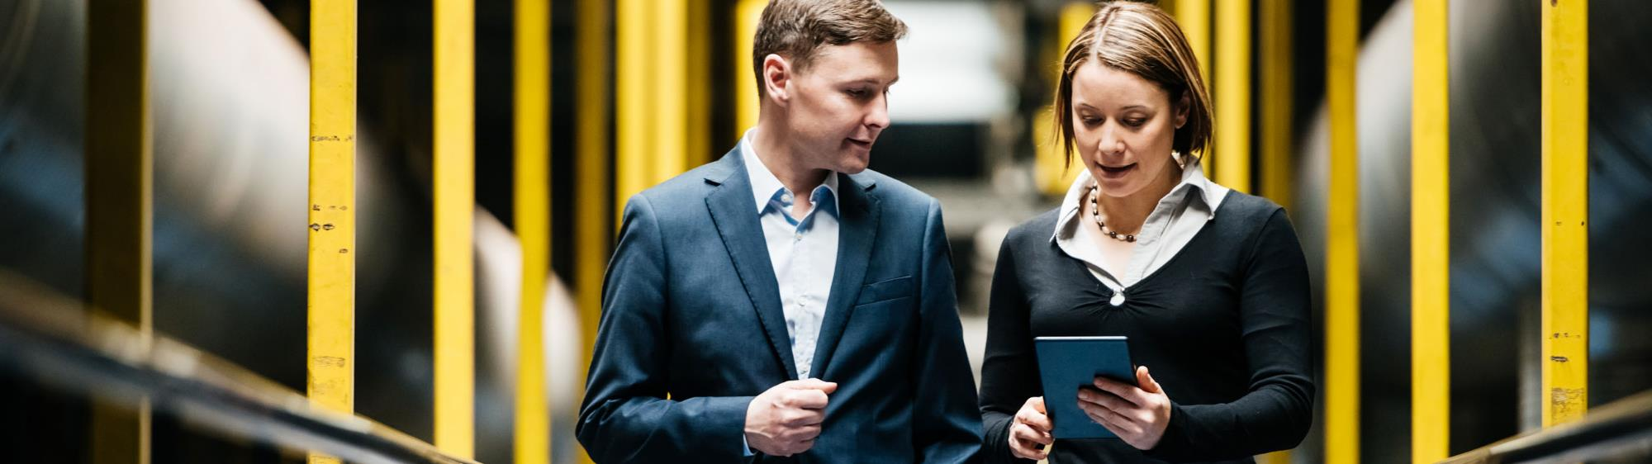
Python Intro and Math Foundation Speaker: Raja Ram Kankipati, Sundeep Gullapudi
Tech-Know School

Slide 2
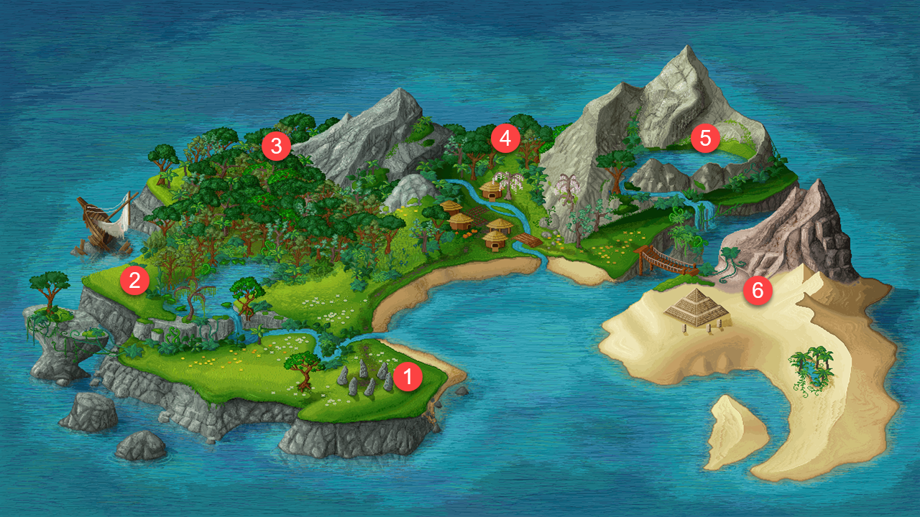
Tech-Know School Island
EDA and Visualization
ML Algorithms
PAL and APL
Python Intro and Math Foundation
Intro to ML and Data Science
SAP Leonardo

Slide 3
Topics Covered:
Variables
Statements
Operators
Decision Making
Functions
Data Structures

Slide 4
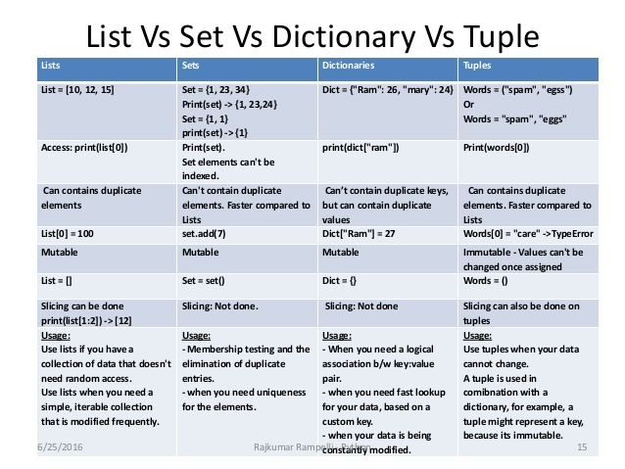

Slide 5
Topics for today:
NumPy
Pandas
Linear Algebra
Visualization
EDA

Slide 6
Thank you.
Partner logo

